Slide 1
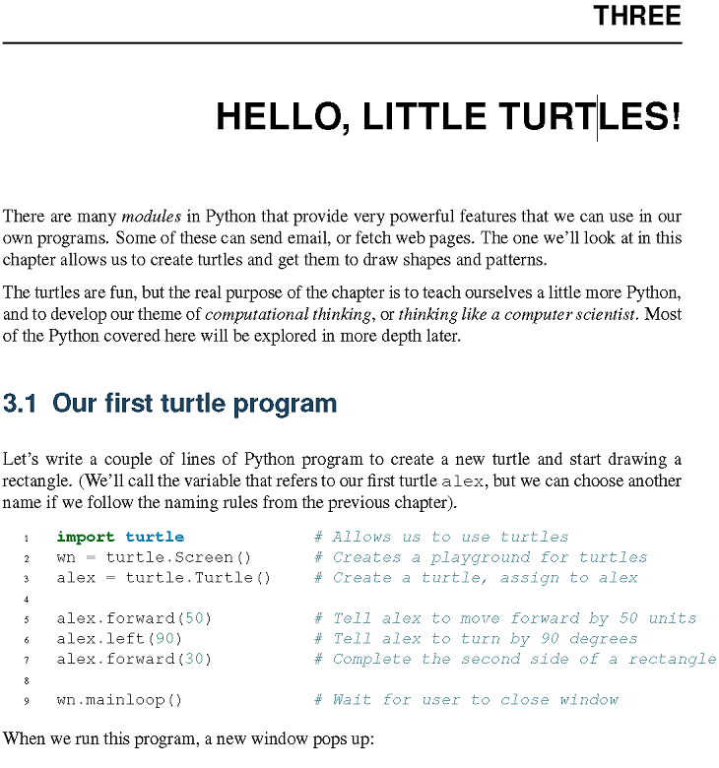

Slide 2
import turtle # Allows us to use turtles
wn = turtle.Screen() # Creates a playground for turtles
alex = turtle.Turtle() # Create a turtle, assign to alex
alex.forward(50) # Tell alex to move forward by 50 units
alex.left(90) # Tell alex to turn by 90 degrees
alex.forward(30) # Complete the second side of a rectangle
wn.mainloop() # Wait for user to close window

Slide 3
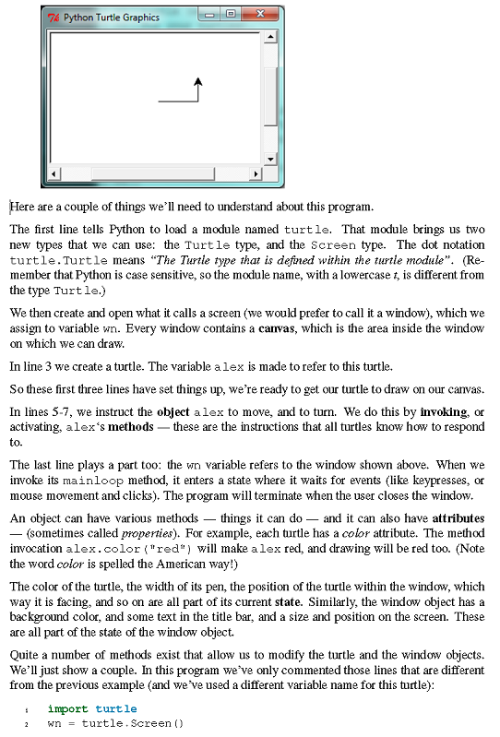

Slide 4
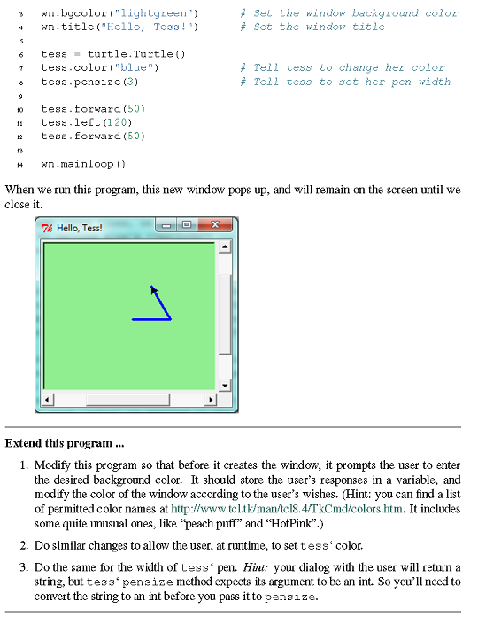

Slide 5
import turtle
wn = turtle.Screen()
wn.bgcolor("lightgreen") # Set the window background color
wn.title("Hello, Tess!") # Set the window title
tess = turtle.Turtle()
tess.color("blue") # Tell tess to change her color
tess.pensize(3) # Tell tess to set her pen width
tess.forward(50)
tess.left(120)
tess.forward(50)
wn.mainloop()

Slide 6
***************************
WS ch3_1:
Modify this program so that before it creates the window, it prompts the user to enter
the desired background color. It should store the user’s responses in a variable, and
modify the color of the window according to the user’s wishes. (Hint: you can find a list
of permitted color names at http://www.tcl.tk/man/tcl8.4/TkCmd/colors.htm. It includes
some quite unusual ones, like “peach puff” and “HotPink”.)
**********************************************
Import turtle
bg = input(“What color would you like the background.”)
wn = turtle.Screen()
wn.bgcolor(bg)
**************************************************
WS ch3_2:
Do similar changes to allow the user, at runtime, to set tess‘ color.
******************************************************
tc = input("What color would you like the turtle to be?")
alex = turtle.Turtle()
alex.color(tc)

Slide 7
**************************************************
WS ch3_3:
Do the same for the width of tess‘ pen. Hint: your dialog with the user will return a
string, but tess‘ pensize method expects its argument to be an int. So you’ll need to
convert the string to an int before you pass it to pensize.
**************************************************
tc = input("What color would you like the turtle to be?")
alex = turtle.Turtle()
alex.pensize(int(ps))
alex.color(tc)

Slide 8
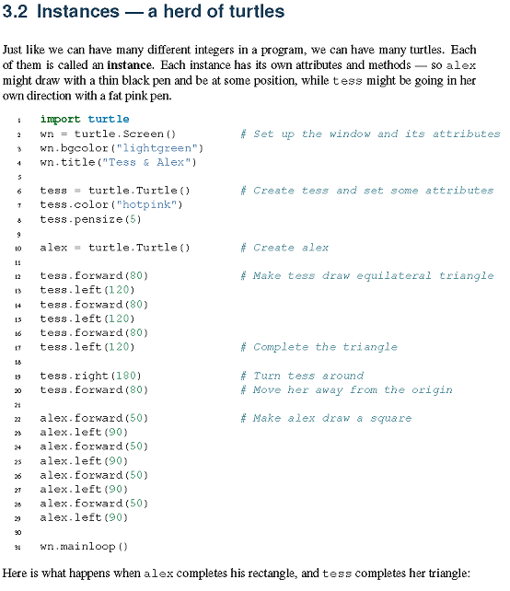

Slide 9
import turtle
wn = turtle.Screen() # Set up the window and its attributes
wn.bgcolor("lightgreen")
wn.title("Tess & Alex")
tess = turtle.Turtle() # Create tess and set some attributes
tess.color("hotpink")
tess.pensize(5)
alex = turtle.Turtle() # Create alex
tess.forward(80) # Make tess draw equilateral triangle
tess.left(120)
tess.forward(80)
tess.left(120)
tess.forward(80)
tess.left(120) # Complete the triangle
tess.right(180) # Turn tess around
tess.forward(80) # Move her away from the origin
alex.forward(50) # Make alex draw a square
alex.left(90)
alex.forward(50)
alex.left(90)
alex.forward(50)
alex.left(90)
alex.forward(50)
alex.left(90)
wn.mainloop()

Slide 10
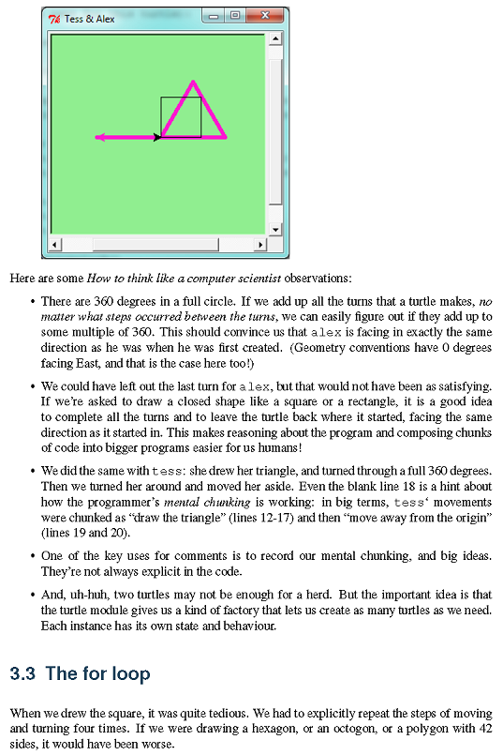

Slide 11
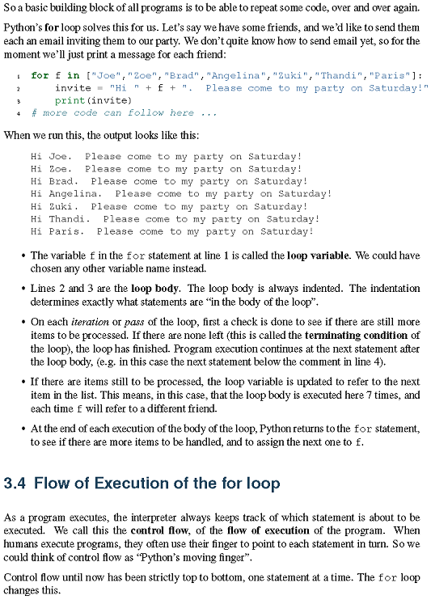

Slide 12
for f in ["Joe","Zoe","Brad","Angelina","Zuki","Thandi","Paris"]:
invite = "Hi " + f + ". Please come to my party on Saturday!"
print(invite)
# more code can follow here ...

Slide 13
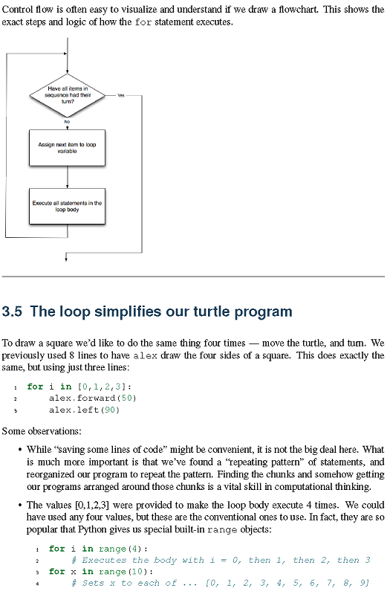

Slide 14
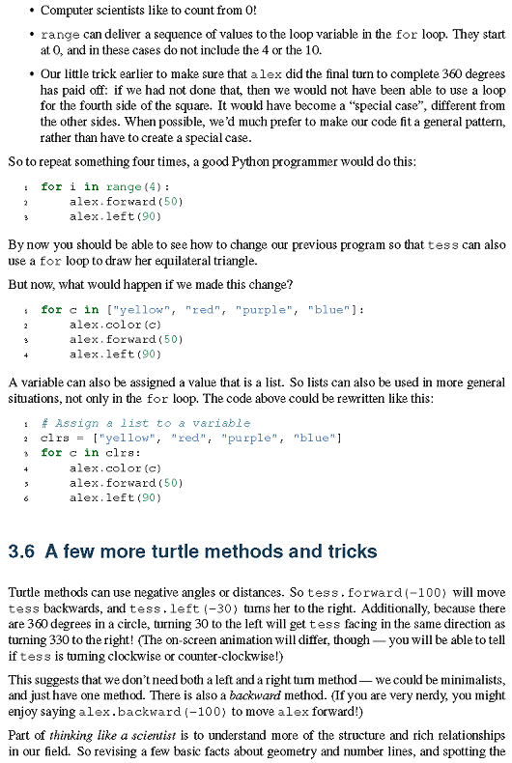

Slide 15
for i in range(4):
# Executes the body with i = 0, then 1, then 2, then 3
for x in range(10):
# Sets x to each of ... [0, 1, 2, 3, 4, 5, 6, 7, 8, 9]
for i in range(4):
alex.forward(50)
alex.left(90)
for c in ["yellow", "red", "purple", "blue"]:
alex.color(c)
alex.forward(50)
alex.left(90)
# Assign a list to a variable
clrs = ["yellow", "red", "purple", "blue"]
for c in clrs:
alex.color(c)
alex.forward(50)
alex.left(90)

Slide 16
***************************************
WS ch3_4 (Ex 3):
Write a program that uses a for loop to print
One of the months of the year is January
One of the months of the year is February
…
***************************************
months = ['January', 'February', 'March', 'April’, 'May', 'June', 'July', 'August', 'September', 'October', 'November', 'December']
for i in months:
print(f'One of the months of the year is {i}')

Slide 17


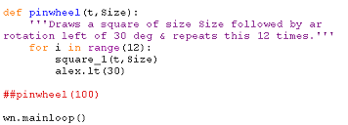

Slide 18
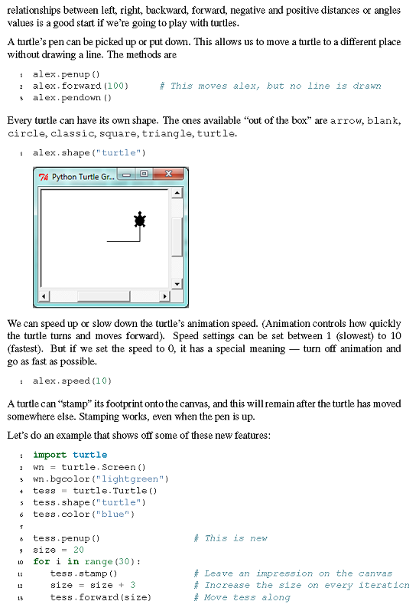

Slide 19
***************************************
WS ch3_4A :
Write a program that uses a for loop to print
a rectangle using a function, rectangle(t,w,h),
Using turtle, t, width, w, and height,h.
***************************************
def rectangle(t, h, w):
for i in range(2):
t.fd(h)
t.rt(90)
t.fd(w)
t.rt(90)
***************************************
WS ch3_4B:
Use rectangle(t,w,h) to write a function,
pinwheel_1(t,w,h,n), that uses rectangle(t,w,h) to make a pinwheel using turtle, t. n is an int that tells how many rectangles to make within a turn of 360 degrees.
***************************************
def pinwheel_1(t, h, w, n):
rot = 360 / n
for i in range(1, n+1):
rectangle(t, h, w)
t.rt(rot)

Slide 20
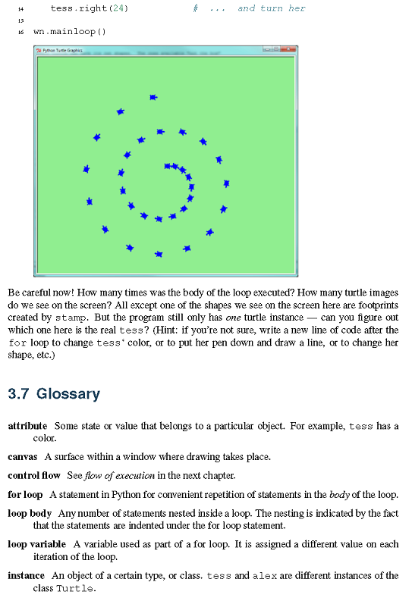

Slide 21
import turtle
wn = turtle.Screen()
wn.bgcolor("lightgreen")
tess = turtle.Turtle()
tess.shape("turtle")
tess.color("blue")
tess.penup() # This is new
size = 20
for i in range(30):
tess.stamp() # Leave an impression on the canvas
size = size + 3 # Increase the size on every iteration
tess.forward(size) # Move tess along
tess.right(24) # ... and turn her
wn.mainloop()

Slide 22
##sumAcum.py
print('First example:')
Sum = 0 ## init sum accumulator to zero
for num in range(1,4): ## num ranges from 1 to 3
Sum = Sum + num ## every time thru loop, add the next int to Sum
print(Sum) ## print out current value of Sum
print() ## print out a blank line
print('Second example:')
Sum1 = 0
for num in range(1,10,2): ## num range over 1,3,5,7,9
Sum1 = Sum1 + num ## every time thru loop, add the next int to Sum
print(Sum1) ## print out current value of Sum
## prodAcum.py
product = 1 ## init product accumulator to one
for num in range(1,4): ## num ranges from 1 to 3
product = product * num ## every time thru loop, mult the next int into product
print(product) ## print out current value of product

Slide 23
*********************************************
WS ch3_5
Initialize a sum accumulator to 0, then use a for loop & a range statement to add the ints from 1 to 10.
********************************************
sum_accumulator = 0
for i in range(1, 11):
sum_accumulator += i
print(sum_accumulator)
************************************************
WS ch 3_6
Initialize a product accumulator to 1, then use a for loop & a range statement to multiply the ints from 1 to 5.
************************************************
prod_accumulator = 1
for i in range(1, 6):
prod_accumulator *= i
print(prod_accumulator)

Slide 24
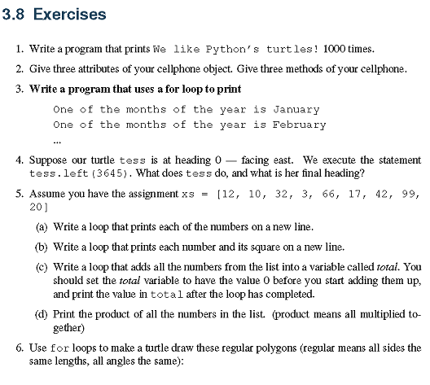

Slide 25
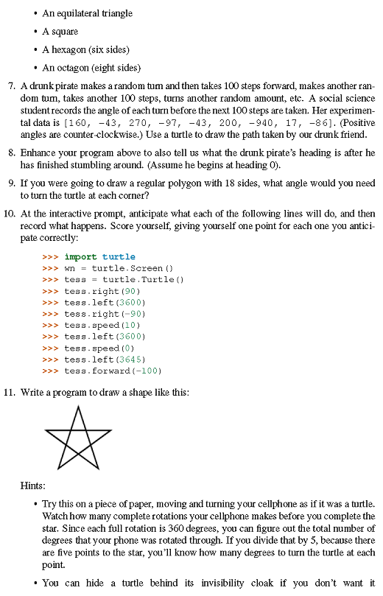

Slide 26
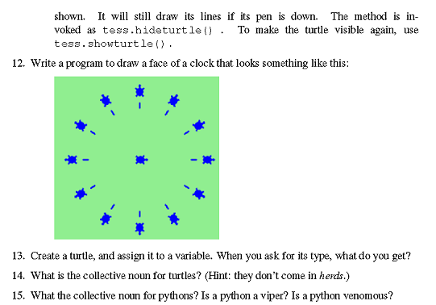

Slide 27
HW ch 3:
3,5,6,7,11
Youtube: 12

